Slide 1
Chapter 6
Registers and Counters

Slide 2
Registers
A register is a group of flip‐flops, each one of which shares a common clock and is capable of storing one bit of information.
An n ‐bit register consists of a group of n flip‐flops capable of storing n bits of binary information.
In addition to the flip‐flops, a register may have combinational gates that perform certain data‐processing tasks.

Slide 3
Counters
A counter is essentially a register that goes through a predetermined sequence of binary states.
The gates in the counter are connected in such a way as to produce the prescribed sequence of states.
Although counters are a special type of register, it is common to differentiate them by giving them a different name.

Slide 4
A Simple 4 bit Register
The simplest register is one that consists of only flip‐flops, without any gates
The common clock input triggers all flip‐flops on the positive edge of each pulse, and the binary data available at the four inputs are transferred into the register.
The input Clear_b goes to the active‐low R (reset) input of all four flip‐flops. When this input goes to 0, all flip‐flops are reset asynchronously

Slide 5
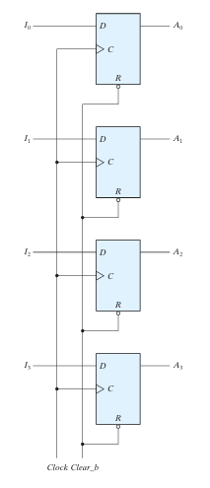
Simple 4 bit Register using D Flip-flops

Slide 6
Problems with Simple Register
In this configuration, if the contents of the register must be left unchanged, the inputs must be held constant or the clock must be inhibited from the circuit.
In the first case, the data bus driving the register would be unavailable for other traffic.
In the second case, the clock can be inhibited from reaching the register by controlling the clock input signal with an enabling gate.

Slide 7
Register with Parallel Load
The transfer of new information into a register is referred to as loading or updating the register.
If all the bits of the register are loaded simultaneously with a common clock pulse, we say that the loading is done in parallel
A four‐bit data‐storage register with a load control input that is directed through gates and into the D inputs of the flip‐flops
The load input to the register determines the action to be taken with each clock pulse.
When the load input is 1, the data at the four external inputs are transferred into the register with the next positive edge of the clock.
When the load input is 0, the outputs of the flip‐flops are connected to their respective inputs.

Slide 8
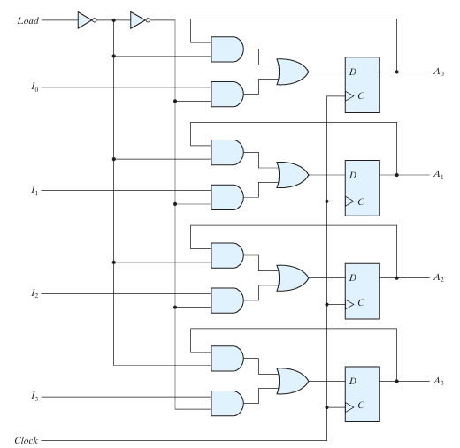
Register with Parallel Load

Slide 9
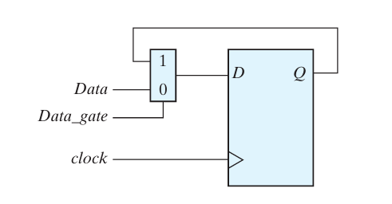
Question
Draw the logic diagram of a circuit that suspends the clock action of a D flip-flop without gating its clock. Describe the behavior of the circuit.

Slide 10
Shift Registers
A register capable of shifting the binary information held in each cell to its neighboring cell, in a selected direction, is called a shift register.
The logical configuration of a shift register consists of a chain of flip-flops in cascade, with the output of one flip-flop con nected to the data input of the next flip-flop.
The simplest possible shift register is one that uses only flip-flops

Slide 11
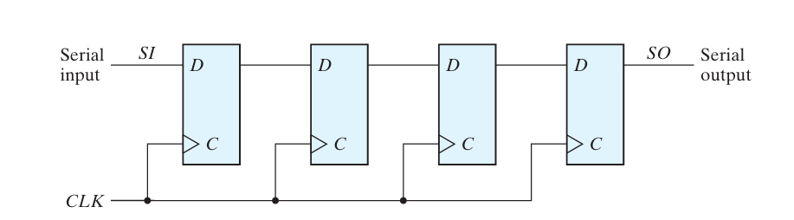
4-bit Shift Register

Slide 12
Serial Transfer
The datapath of a digital system is said to operate in serial mode when information is transferred and manipulated one bit at a time.
Information is transferred one bit at a time by shifting the bits out of the source register and into the destination register.
This type of transfer is in contrast to parallel transfer, whereby all the bits of the register are transferred at the same time.

Slide 13
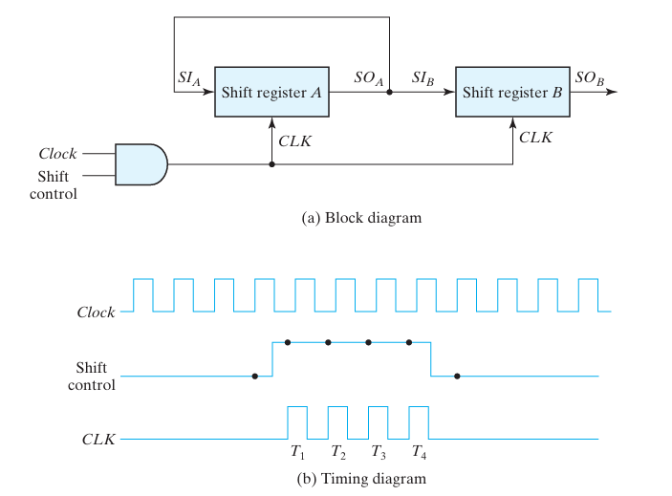
Serial Transfer

Slide 14
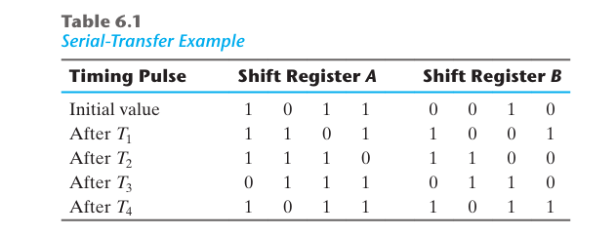
Serial Shift Example

Slide 15
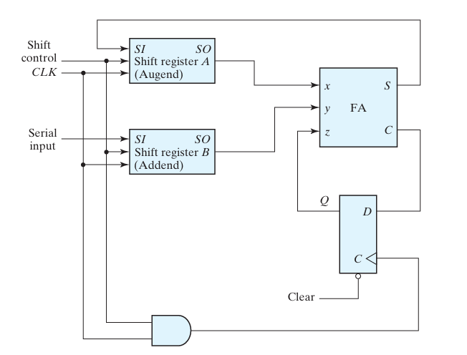
Serial Addition (Diagram)

Slide 16
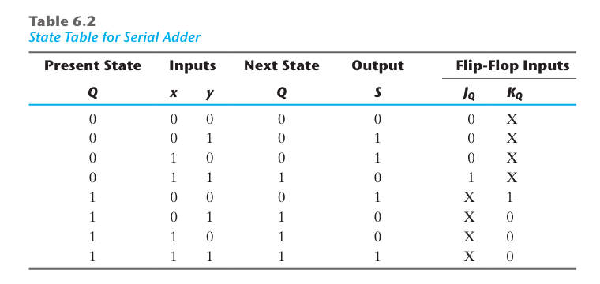
Serial Addition (State Table)

Slide 17
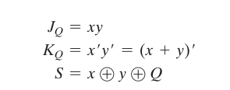
Serial Addition (Equations)

Slide 18
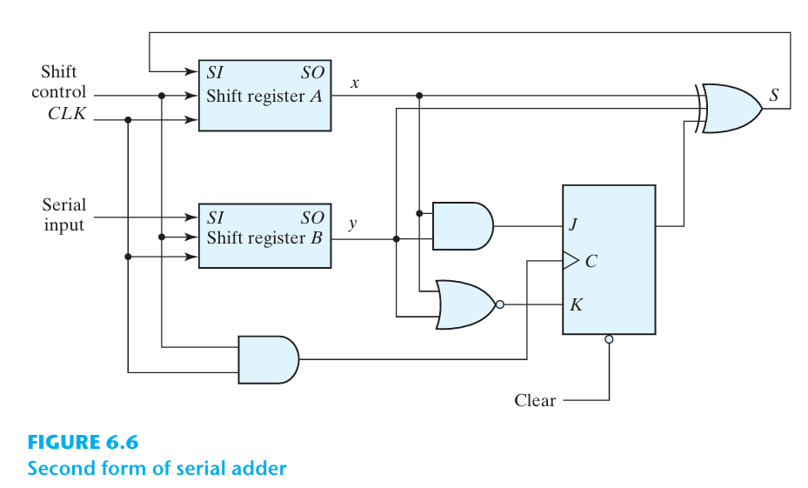
Serial Adder

Slide 19
Universal Shift Register
The most general shift register has the following capabilities:
A clear control to clear the register to 0.
A clock input to synchronize the operations.
A shift-right control to enable the shift-right operation and the serial input and output lines associated with the shift right.
A shift-left control to enable the shift-left operation and the serial input and output lines associated with the shift left.
A parallel-load control to enable a parallel transfer and the n input lines associated with the parallel transfer.
n parallel output lines.
A control state that leaves the information in the register unchanged in response to the clock.

Slide 20
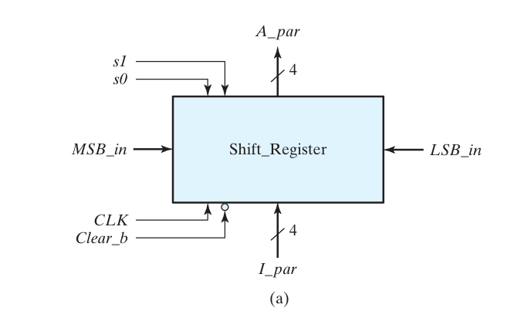
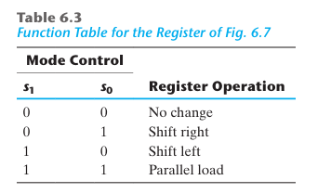
Universal Shift Register

Slide 21
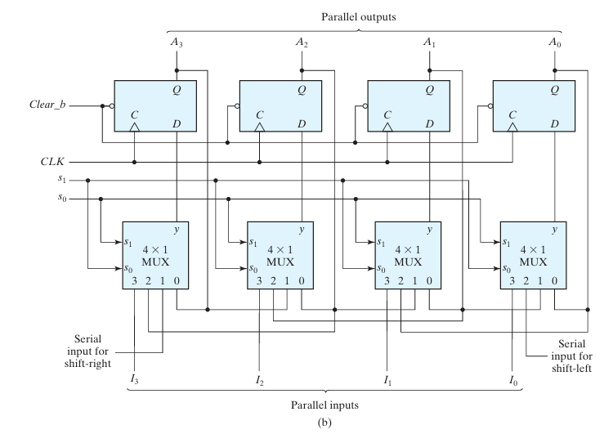

Slide 22
Counters
A register that goes through a prescribed sequence of states upon the application of input pulses is called a counter.
The input pulses may be clock pulses, or they may originate from some external source and may occur at a fixed interval of time or at random.
An n-bit binary counter consists of n flip-flops and can count in binary from 0 through 2^n- 1

Slide 23
Counter Types
Counters are available in two categories: ripple counters and synchronous counters.
In a ripple counter, a flip-flop output transition serves as a source for triggering other flip-flops. In other words, the clock input of some or all flip-flops are triggered, not by the common clock pulses, but rather by the transition that occurs in other flip-flop outputs.
In a synchronous counter, the clock inputs of all flip-flops receive the common clock. Synchronous counters are presented in the next two sections.

Slide 24
Binary Ripple Counter
The count starts with binary 0 and increments by 1 with each count pulse input. After the count of 15, the counter goes back to 0 to repeat the count.
The least significant bit, A0, is complemented with each count pulse input. Every time that A0 goes from 1 to 0, it complements A1. Every time that A1 goes from 1 to 0, it complements A2. Every time that A2 goes from 1 to 0, it complements A3 and so on for any other higher order bits of a ripple counter

Slide 25
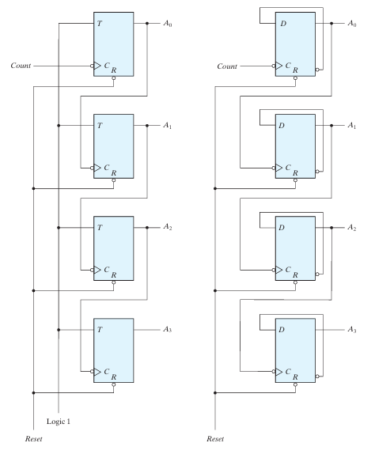

Slide 26
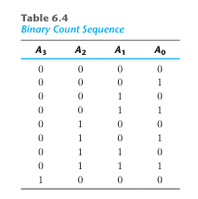
Binary Ripple Counter Sequence

Slide 27
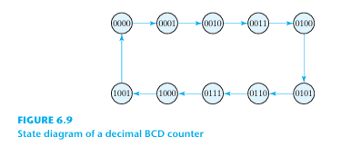
BCD Ripple Counter

Slide 28
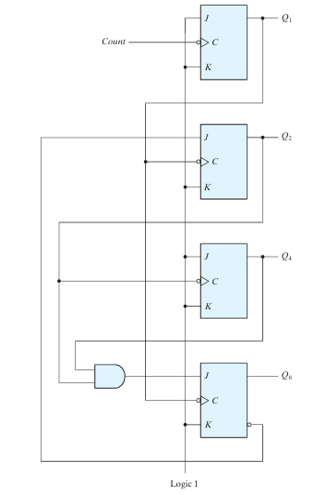

Slide 29
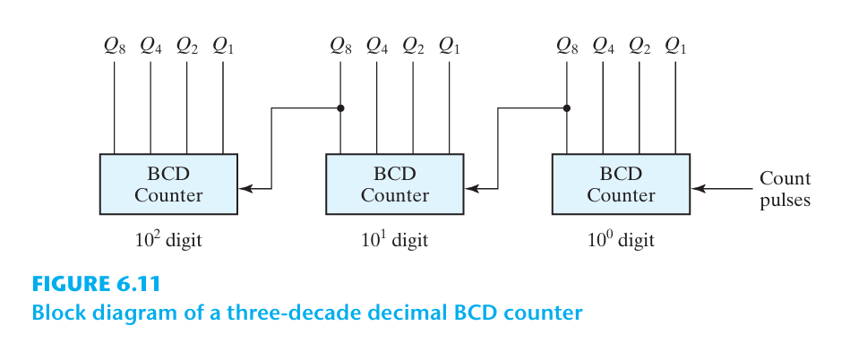
BCD Counter 0-999

Slide 30
Synchronous counters
Synchronous counters are different from ripple counters in that clock pulses are applied to the inputs of all flip-flops.
A common clock triggers all flip-flops simultaneously, rather than one at a time in succession as in a ripple counter.
The decision whether a flip-flop is to be complemented is determined from the values of the data inputs, such as T or J and K at the time of the clock edge

Slide 31
Binary Counter
In a synchronous binary counter, the flip-flop in the least significant position is complemented with every pulse.
A flip-flop in any other position is complemented when all the bits in the lower significant positions are equal to 1

Slide 32
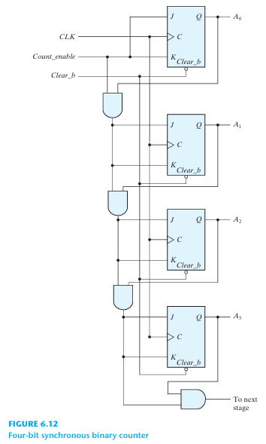

Slide 33
Up–Down Binary Counter
A synchronous countdown binary counter goes through the binary states in reverse order, from 1111 down to 0000 and back to 1111 to repeat the count
The bit in the least significant position is complemented with each pulse. A bit in any other position is complemented if all lower significant bits are equal to 0.

Slide 34
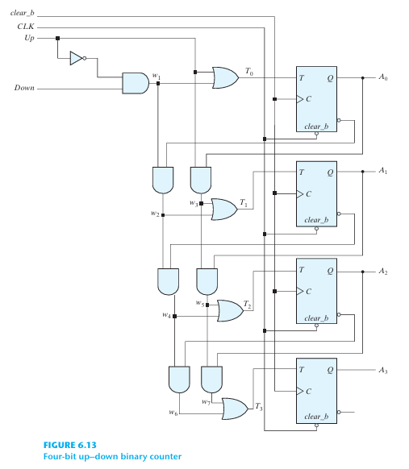

Slide 35
Up-Down Counter
It has an up control input and a down control input.
When the up input is 1, the circuit counts up, since the T inputs receive their signals from the values of the previous normal outputs of the flip-flops.
When the down input is 1 and the up input is 0, the circuit counts down, since the complemented outputs of the previous flip-flops are applied to the T inputs.
When the up and down inputs are both 0, the circuit does not change state and remains in the same count.
When the up and down inputs are both 1, the circuit counts up. This set of conditions ensures that only one operation is performed at any given time.
Note that the up input has priority over the down input

Slide 36
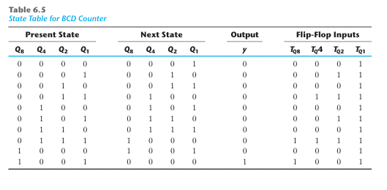
BCD Counter

Slide 37
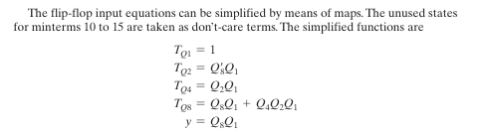
BCD Counter

Slide 38
Binary Counter with Parallel Load
Counters employed in digital systems quite often require a parallel-load capability for transferring an initial binary number into the counter prior to the count operation.
When equal to 1, the input Load disables the count operation and causes a transfer of data from the four data inputs into the four flip-flops.
If inputs Load and Count are both 0, clock pulses do not change the state of the register.

Slide 39
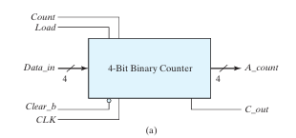
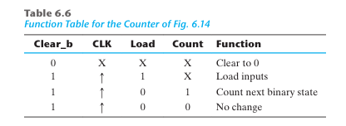
Binary Counter with Parallel Load

Slide 40
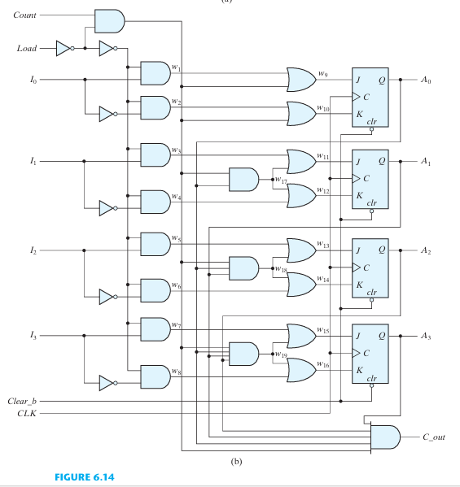

Slide 41
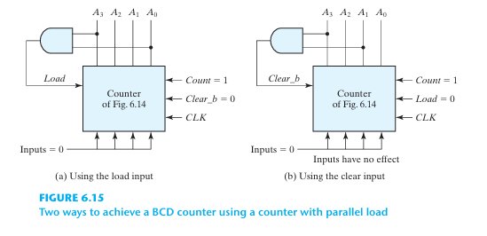
BCD Counter Using the Binary Counter with Load

Slide 42
Counter with Unused States
A circuit with n flip-flops has 2n binary states.
There are occasions when a sequential circuit uses fewer than this maximum possible number of states.
States that are not used in specifying the sequential circuit are not listed in the state table.
In simplifying the input equations, the unused states may be treated as don’t-care conditions or may be assigned specific next states.

Slide 43
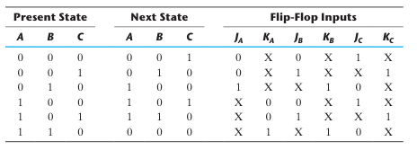
Counter with Unused States

Slide 44

Counter with Unused States

Slide 45
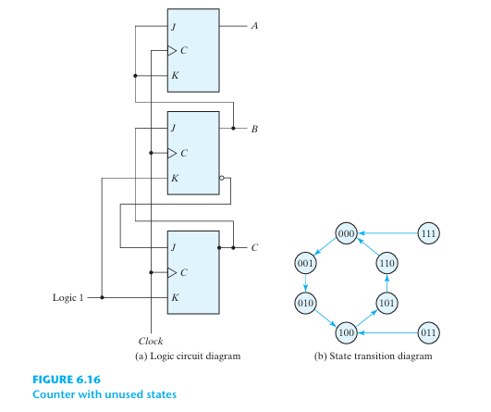
Counter with unused States

Slide 46
Ring Counter
A ring counter is a circular shift register with only one flip-flop being set at any particular time; all others are cleared.
The single bit is shifted from one flip-flop to the next to produce the sequence of timing signals.
The initial value of the register is 1000 and requires Preset/ Clear flip-flops. The single bit is shifted right with every clock pulse

Slide 47
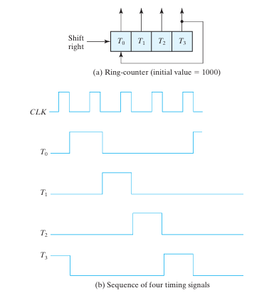
Ring Counter

Slide 48
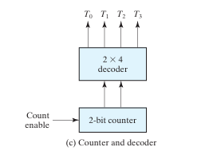
Ring Counter

Slide 49
Johnson Counter
A k-bit ring counter circulates a single bit among the flip-flops to provide k distinguish able states.
The number of states can be doubled if the shift register is connected as a switch-tail ring counter.
A switch-tail ring counter is a circular shift register with the complemented output of the last flip-flop connected to the input of the first flip-flop.
The decoding gates are not shown in Fig. 6.18, but are specified in the last column of the table.
The eight AND gates listed in the table, when connected to the circuit, will complete the construction of the Johnson counter.

Slide 50
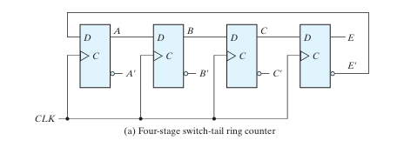
Johnson Counter

Slide 51
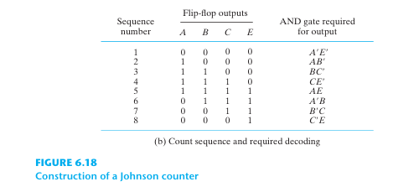
Johnson Counter

Slide 52
Johnson Counter
One disadvantage of the circuit in Fig. is that if it finds itself in an unused state, it will persist in moving from one invalid state to another and never find its way to a valid state.
The difficulty can be corrected by modifying the circuit to avoid this undesirable condition.

